Slide 1
Web Suggestions for unification
Suggested Banner example
suggested Background example
Suggested Color Scheme

Slide 2
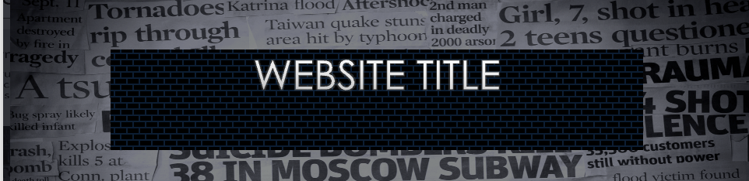
Example of a banner for site with the newspaper under the banner and a purple/black box
with white text or a tint of the color scheme colors (last page)
This is an example for discussion purposes
idea is to fill the banner with B&W newspaper, layer a box wit gradient, add text in box
I would not have text be top-centered (like here)
I would suggest bottom center or center center

Slide 3


Slide 4
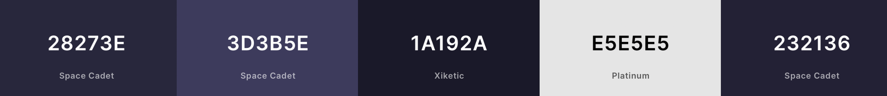
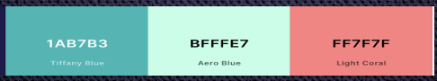
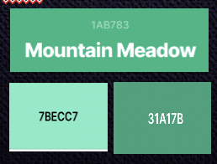
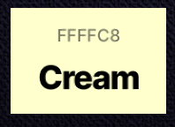
Color HEX CODES:
Main color hex codes: 28273E & 3D3B5E
Current Font: Century Gothic
Color Source:
https://coolors.co
Actual Tiff Blue Hex: 0ABAB5
Mountain Meadow is what
appears when using the
Tiff Blue Hex Color in the color
strip
Possible Accent Colors
Possible Alt to Tiff Blue
Possible Alt to Coral

